Slide 1
Temperature in the LBD Cooperative Effort Area
2018 – 2022 Weekly Average and Daily Maximum data Compilation

Slide 2
Notes for changes
Round all temps to the nearest 0.1 deg C
Change the exceedance summary boxes to table format (see slides 45-52 for example)

Slide 3
Overview - Temperature Monitoring in CEA
67 sites in the CEA (54 assessed)
Sites maintained by GCWIN, Northern Water, USGS, BLM
Financial support from many stakeholders
LBD program supplemental to existing monitoring
Notes:
Cross reference site matrix to confirm “67”

Slide 4
Stream Temperature Program Objectives
Complement existing stream temperature monitoring efforts;
Provide the LBD operations subcommittee with timely data to make informed decisions about releases of environmental water;
Provide stream temperature data to evaluate effectiveness of environmental water releases;
Identify critical stream reaches for water temperature;
Assess compliance with Colorado's stream temperature standards;
Monitor and assess impacts of restoration efforts performed by LBD

Slide 5
Colorado Temperature Standards
Acute Standard
Daily Maximum
Highest 2-hr average in 24-hrs
CS-I
21.7 (Jun – Sep)
13.0 (Oct – May)
CS-II
24.3 (Apr – Oct)
13 (Nov – Mar)
Chronic Standard
Maximum Weekly Average
7-day moving average
CS-I
17.0 (Jun – Sep)
9.0 (Oct – May)
CS-II
18.3 (Apr – Oct)
9.0 (Nov – Mar)
The chronic standard protects fish from conditions that might reduce their growth and reproduction.
The acute standard protects fish from temperatures that could result in fatality.
Assessment Period: Previous 5 years
All temperature standards in ⁰C

Slide 6
2022 LBD Stream Temperature Program
GCWIN Stream Temperature Program with LBD
In 2022, 11 sites were sponsored by Learning by Doing. Stream Temperature data was collected by GCWIN and reviewed on a weekly basis to inform the Operations Subcommittee
River Mile ID and Station Description
(STC-0) Saint Louis Creek at confluence of Fraser River (Weekly Review)
(FR-3.5) Fraser River at Hwy 40 Granby (Weekly Review)
(CR-2.3) Colorado River above Hwy 9 Bridge in Kremmling (Weekly Review)
(FR-15) Fraser Flats River Habitat Project Upstream
(FR-14.4) Fraser Flats River Habitat Project Downstream
(STC-5.4) Saint Louis Creek near Fraser Experimental Forest
(WC-0.5) Willow Creek near confluence of Colorado River (Photos Taken)
(WC-2.3) Willow Creek above Bunte Highline Ditch (Photos Taken)
(WF-5.5) Williams Fork upstream of the reservoir (Photos Taken)
(RC-5.8) Ranch Creek above Quad Ranch revegetation area
(RC-5.1) Ranch Creek below Quad Ranch revegetation area
Total Costs in 2022 for 11 sites monitored by GCWIN: $7,841.28
Notes:
Make this slide focus on what LBD pays. Make this slide match SOW for 2022. During this presentation, we will only focus on operational sites, and other sites of interest. All sites are available in yearly report.

Slide 7
Fraser River Basin, including tributaries 2022 Summary

Slide 8
2022 Fraser River Basin Exceedances
8 sites above the (DM) state temperature threshold for acute (2-hr) exposure:
(RC-1.1) Ranch Creek below Meadow Creek
(RC 5.8) Ranch Creek above Quad Ranch
(RC 5.1) Ranch Creek below Quad Ranch
(MC 0.5) Meadow Creek at CR 84
(STC-0) St. Louis Creek
(FR 3.5) Fraser River at highway 40 in Granby
(FR 1.9) Fraser River above and below Grandy Sanitation District
(FR 1.6) Fraser River above and below Grandy Sanitation District
9 sites above the (WAT) state temperature threshold for chronic (7-day) exposure:
(RC-1.1) Ranch Creek below Meadow Creek
(RC 5.8) Ranch Creek above Quad Ranch
(RC 5.1) Ranch Creek below Quad Ranch
(MC 0.5) Meadow Creek at CR 84
(STC-0) St. Louis Creek
(FR 3.5) Fraser River at highway 40 in Granby
(FR 1.9) Fraser River above and below Grandy Sanitation District
(FR 1.6) Fraser River above and below Grandy Sanitation District
(FR 4.5 ) Fraser river below Fraser canyon
29 sites assessed
9 sites not in attainment with state temperature standards
Notes:
6/3 were the exceedances for last year

Slide 9
2022 Fraser River Basin Exceedances
8 sites above the (DM) state temperature threshold for acute (2-hr) exposure:
(RC-1.1) Ranch Creek below Meadow Creek
(RC 5.8) Ranch Creek above Quad Ranch
(RC 5.1) Ranch Creek below Quad Ranch
(MC 0.5) Meadow Creek at CR 84
(STC-0) St. Louis Creek
(FR 3.5) Fraser River at highway 40 in Granby
(FR 1.9) Fraser River above and below Grandy Sanitation District
(FR 1.6) Fraser River above and below Grandy Sanitation District
9 sites above the (WAT) state temperature threshold for chronic (7-day) exposure:
(RC-1.1) Ranch Creek below Meadow Creek
(RC 5.8) Ranch Creek above Quad Ranch
(RC 5.1) Ranch Creek below Quad Ranch
(MC 0.5) Meadow Creek at CR 84
(STC-0) St. Louis Creek
(FR 3.5) Fraser River at highway 40 in Granby
(FR 1.9) Fraser River above and below Grandy Sanitation District
(FR 1.6) Fraser River above and below Grandy Sanitation District
(FR 4.5 ) Fraser river below Fraser canyon
29 sites assessed
9 sites not in attainment with state temperature standards
Notes:
6/3 were the exceedances for last year

Slide 10
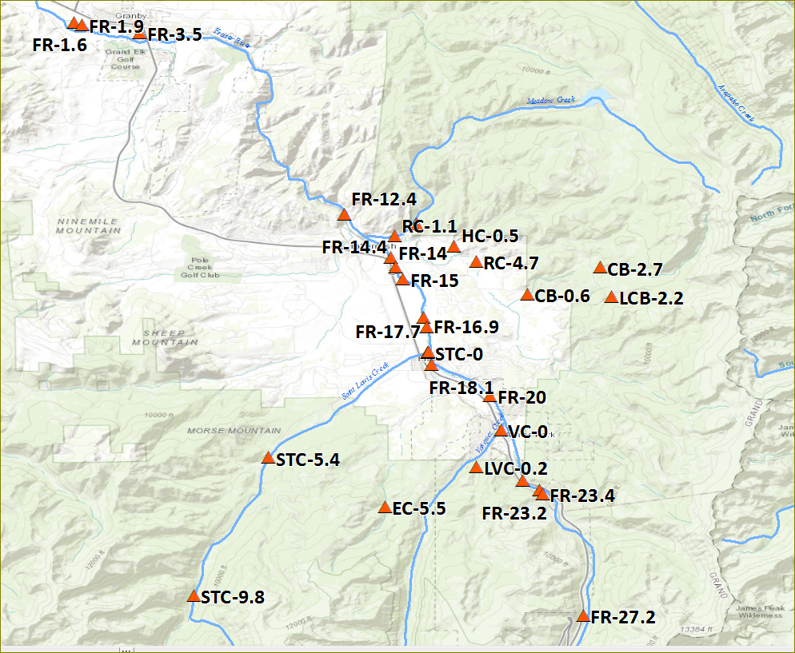
Fraser River and Tributaries
RC-5.1
RC-5.8

Slide 11
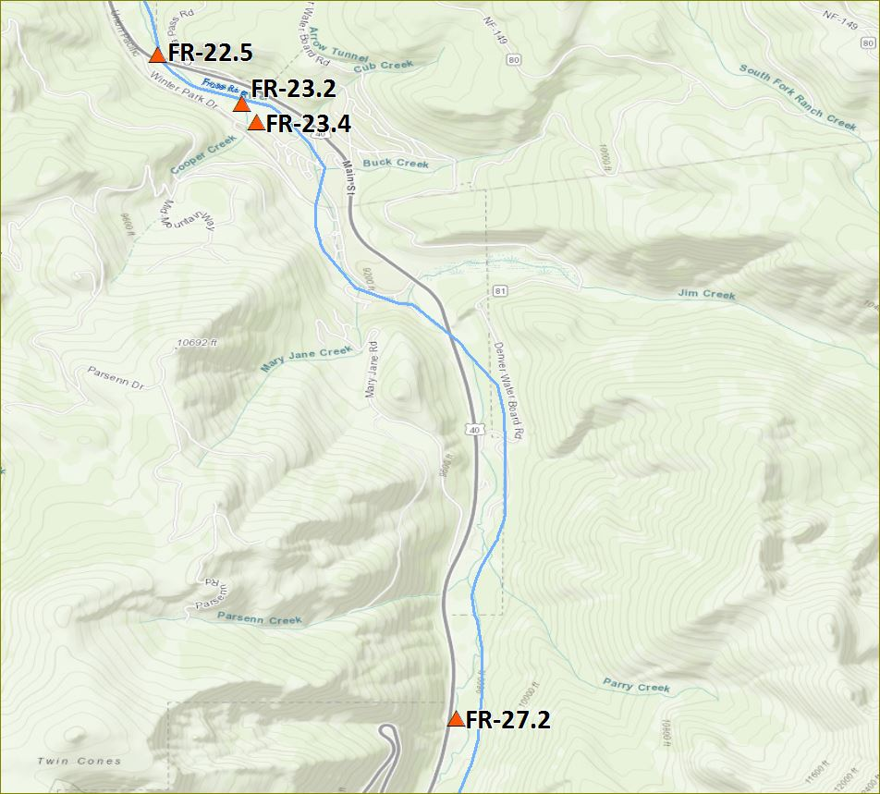
CSI
FR-Upper
FR-27.2

Slide 12
CSI
FR-abvWPSD
FR-23.4

Slide 13
CSI
FR-blwWPSD
FR-23.2

Slide 14
CSI - FR-blwWP - FR-22.5

Slide 15
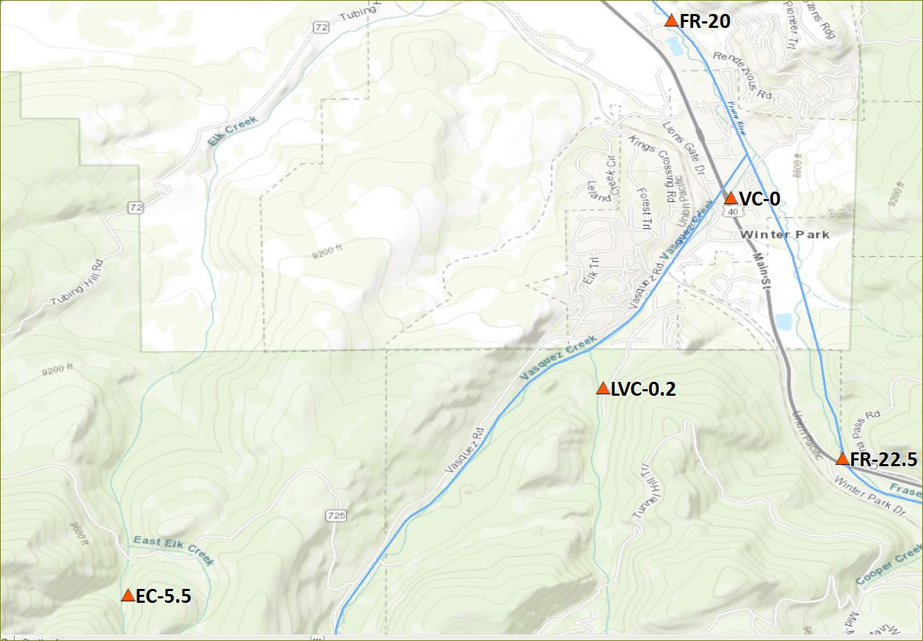
CSI - Elk-blwDWB - EC-5.5

Slide 16
CSI – LVC-abvWP - LVC-0.2

Slide 17
CSI - VC-WP - VC-0
Data Gap:
-2020: Rig found out of water.

Slide 18
CSII - FR20-Rendezvous - FR-20

Slide 19
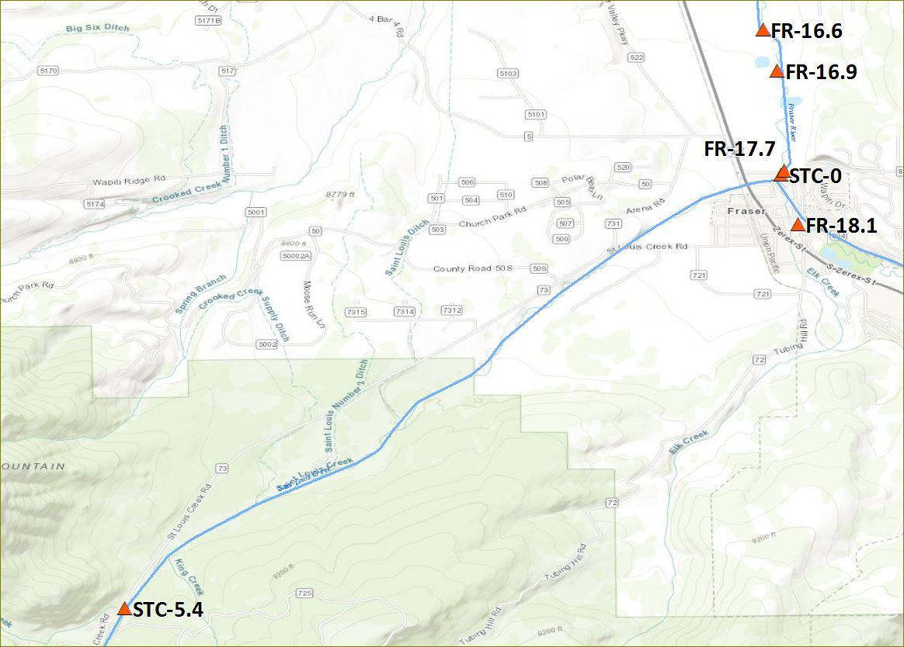
CSII - FR-CR804 - FR-18.1

Slide 20
CSI - STC-blwDWB - STC-9.8

Slide 21
CSI - STC-Mid - STC-5.4

Slide 22
CSI - ST-LC - STC-0
22.57 C on 7/17
2022 Above WAT standard
10-01-2022 | Max Exceedance: 9.07 ⁰C
2022 Above DM standard
05-06-2022 to 05-26-2022 07-17-2022 to 07-20-2022 | Max Exceedance: 14.26 ⁰C Max Exceedance: 22.57 ⁰C
Notes:
Above DM standard max of 21.82 deg C occurred on July 21,2020.

Slide 23
CSII - FR-blwCR8HD - FR-17.7

Slide 24
CSII - FR-abvFSD - FR-16.9

Slide 25
CSII - FR-blwFSD - FR-16.6

Slide 26
CSII - FR-SpProjU - FR-15

Slide 27
CSII - FR-SpProjD - FR-14.4

Slide 28
FR-SpProjU FR-SpProjD

Slide 29
CSI - LCAB-blwDWB - LCB-2.2

Slide 30
CSI - CAB-blwDWB - CB-2.7

Slide 31
CSI - CAB-abvChan - CB-0.6

Slide 32
CSI - RC-abvQuad - RC-5.8
17.77 C on 8/09
RC-5.8
23.28 C on 8/04
2022 Above WAT standard
07-20-2022 08-06-2022 to 08-13-2022 10-01-2022 to 10-02-2022 | Max Exceedance: 17.11 ⁰C Max Exceedance: 17.77 ⁰C Max Exceedance: 9.32 ⁰C
2022 Above DM standard
05-15-2022 07-14-2022 to 07-27-2022 08-03-2022 to 08-11-2022 | Max Exceedance: 13.10 ⁰C Max Exceedance: 23.12 ⁰C Max Exceedance: 23.28 ⁰C

Slide 33
CSII - RC-blwQuad - RC-5.1
18.18 C on 8/08
RC-5.1
25.01 C on 8/04
2022 Above WAT standard
07-18-2022 to 07-23-2022 08-04-2022 to 08-14-2022 | Max Exceedance: 17.55 ⁰C Max Exceedance: 18.14 ⁰C
2023 Above DM standard
07-13-2022 to 07-30-2022 08-01-2022 to 08-11-2022 | Max Exceedance: 24.62 ⁰C Max Exceedance: 25.01 ⁰C

Slide 34
CSI - HRD-atCR843 - HC-0.5

Slide 35
CSI - MEA-atCR84 - MC-0.5
17.68 on 7/20
23.46 C on 8/04
2023 Above WAT standard
07-15-2022 to 07-26-2022 08-08-2022 | Max Exceedance: 17.68 ⁰C Max Exceedance: 17.03 ⁰C
2023 Above DM standard
07-11-2022 to 07-27-2022 08-01-2022 to 08-10-2022 | Max Exceedance: 22.61 ⁰C Max Exceedance: 23.46 ⁰C

Slide 36
CSI - RC-blwMC - RC-1.1
19.17 C on 8/09
24.25 C on 8/04
2023 Above WAT standard
07-15-2022 to 07-31-2022 08-01-2022 to 08-16-2022 10-01-2022 to 10-08-2022 | Max Exceedance: 18.45 ⁰C Max Exceedance: 19.17 ⁰C Max Exceedance: 10.17 ⁰C
2023 Above DM standard
05-15-2022 to 5-26-2022 07-11-2023 to 7-30-2022 08-01-2022 to 8-11-2022 | Max Exceedance: 14.09 ⁰C Max Exceedance: 23.86 ⁰C Max Exceedance: 24.25 ⁰C
Notes:
Compare to USGS site

Slide 37
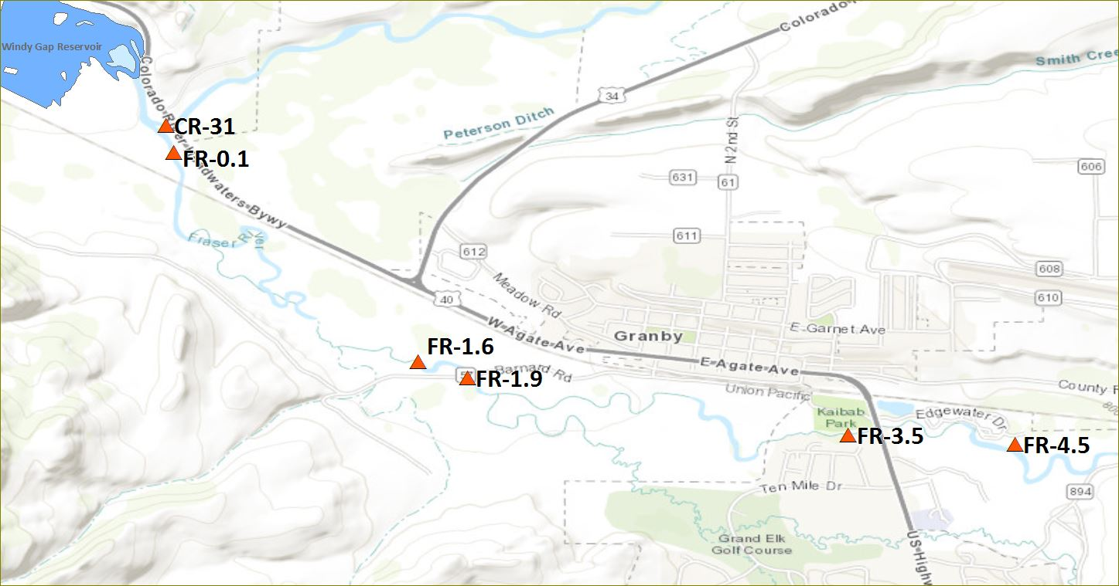
CSII - FR-blwFrCan - FR-4.5
18.77 C on 8/08
2022 Above WAT standard
07-18-2022 to 07-24-2022 08-05-2022 to 08-13-2022 | Max Exceedance: 18.72 ⁰C Max Exceedance: 18.77 ⁰C

Slide 38
CSII - FR-HWY40GR - FR-3.5
19.19 C on 8/09
24.56 C on 8/10
2022 Above WAT standard
07-17-2022 to 07-27-2022 08-04-2022 to 08-15-2022 | Max Exceedance: 19.04 ⁰C Max Exceedance: 19.19 ⁰C
2022 Above DM standard
08-10-2022 to 8-11-2022 | Max Exceedance: 24.56 ⁰C

Slide 39
CSII - FR-abvGSD - FR-1.9
19.25 C on 8/08
24.82 C on 8/10
2022 Above WAT standard
07-17-2022 to 07-27-2022 08-04-2022 to 08-15-2022 | Max Exceedance: 18.99 ⁰C Max Exceedance: 19.25 ⁰C
2022 Above DM standard
08-10-2022 | Max Exceedance: 24.82 ⁰C

Slide 40
CSII​ - FR-blwGSD​ - FR-1.6
19.25 C on 8/08
24.73 C on 8/10
2022 Above WAT standard
07-17-2022 to 07-27-2022 08-04-2022 to 08-15-2022 | Max Exceedance: 18.99 ⁰C Max Exceedance: 19.25 ⁰C
2022 Above DM standard
08-10-2022 | Max Exceedance: 24.73 ⁰C

Slide 41
Weekly
FR-Hwy40GR
FR-Upper
FR-Upper FR-Rendezvous FR-SpProjD FR-blwFRCan FR-Hwy40GR

Slide 42
Colorado River Basin 2022 Summary

Slide 43
Three Lakes/Colorado River/ Williams Fork
4 sites above the (DM) state temperature threshold for acute (2-hr) exposure:
(FR 0.1) Fraser River upstream of confluence with Colorado River
(CR 22.1) Colorado River upstream Hot Sulphur Springs
(WF 5.5) Williams Fork upstream of Williams Fork Reservoir
(NF 0.1) North Fork of Colorado River upstream Shadow Mountain Reservoir
8 sites above the (WAT) state temperature threshold for chronic (7-day) exposure:
(FR 0.1) Fraser River upstream of confluence with Colorado River
(CR 22.1) Colorado River upstream Hot Sulphur Springs
(WF 5.5) Williams Fork upstream of Williams Fork Reservoir
(NF 0.1) North Fork of Colorado River upstream Shadow Mountain Reservoir
(CR 19.8) Colorado River downstream of Byers Canyon
(CR 18.4) Colorado River at Lone Buck
(CR 16.7) Colorado River upstream of Williams Fork
(CR 44.6) Colorado River downstream of Shadow Mountain Reservoir
25 sites assessed
8 sites not in attainment with state temperature standards

Slide 44
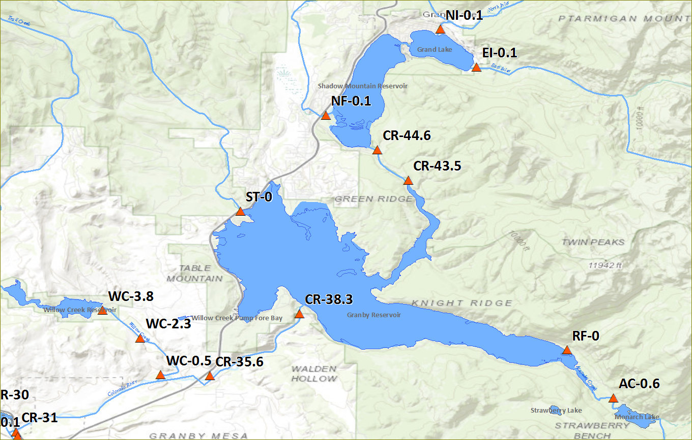
Colorado River – Headwaters to Windy Gap
Notes:
No graphs for sites upstream of Granby Reservoir – DMS upgrade caused delay in data processing

Slide 45
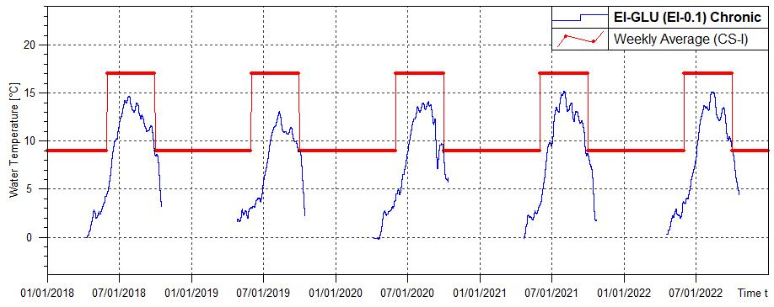
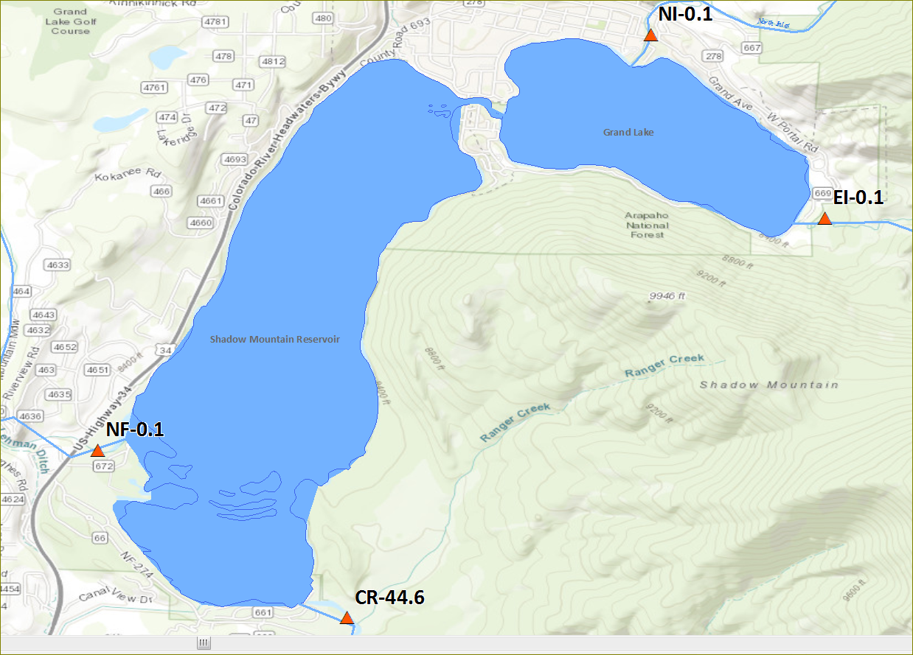
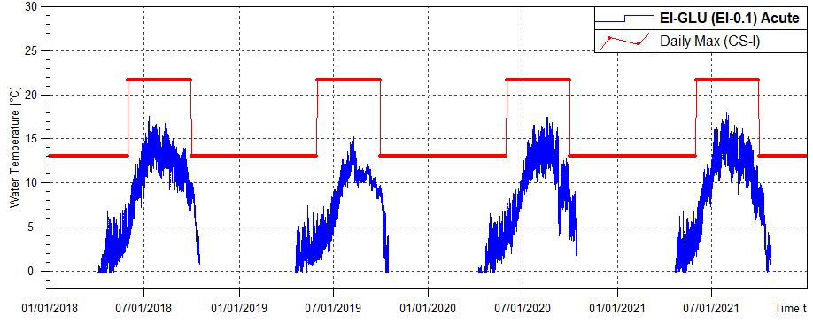
East Inlet - CSI
2022 Above WAT Standard
10-01-2022 | Max Exceedance: 9.1 ⁰C

Slide 46
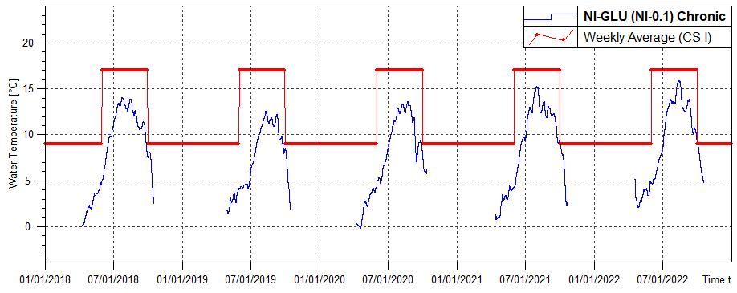
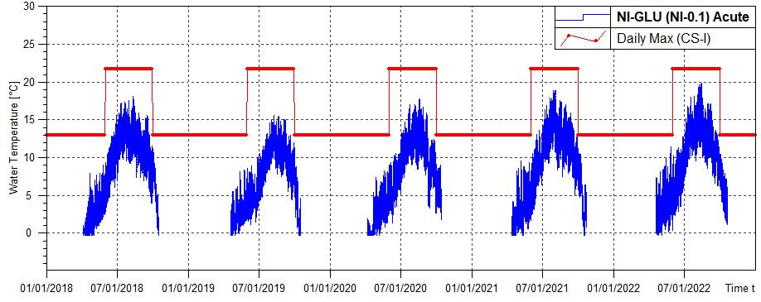
North Inlet - CSI
2022 Above WAT Standard
10/01-10/2/2022 | Max Exceedance: 9.3 ⁰C

Slide 47
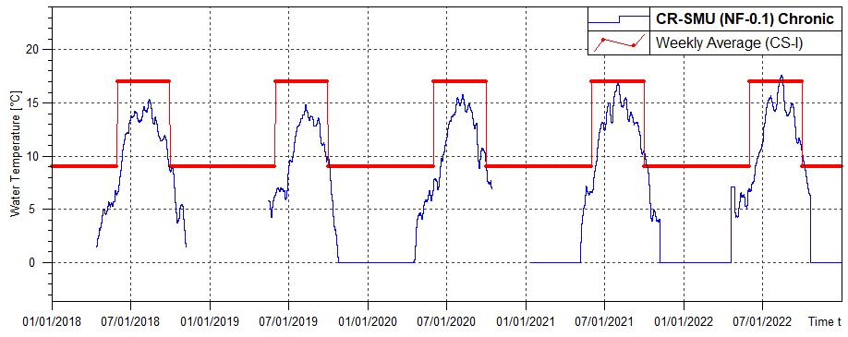
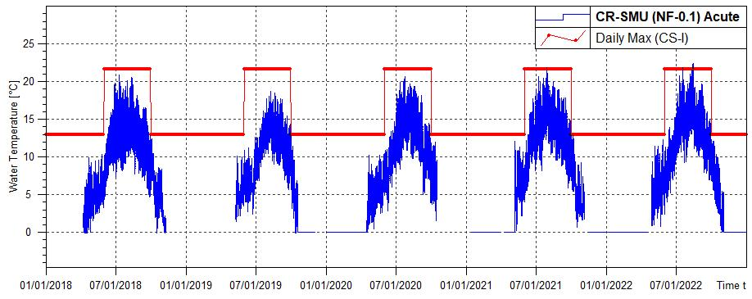
North Fork Colorado - CSI
2022 Above WAT Standard
8/11-8/17/2022 | Max Exceedance: 17.6 ⁰C
10/1-10/5/2022 | Max Exceedance: 10.3 ⁰C
2022 Above DM Standard
7/17/2022 | Max Exceedance: 21.8 ⁰C
8/11/2022 | Max Exceedance: 22.3 ⁰C
8/13/2022 | Max Exceedance: 22.4 ⁰C

Slide 48
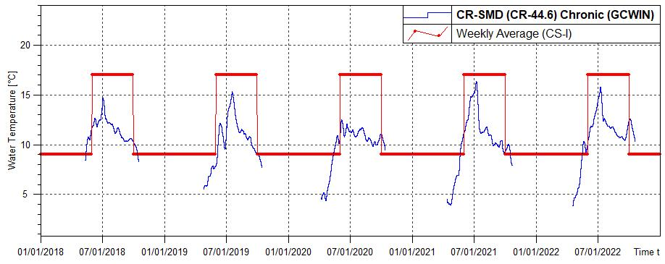
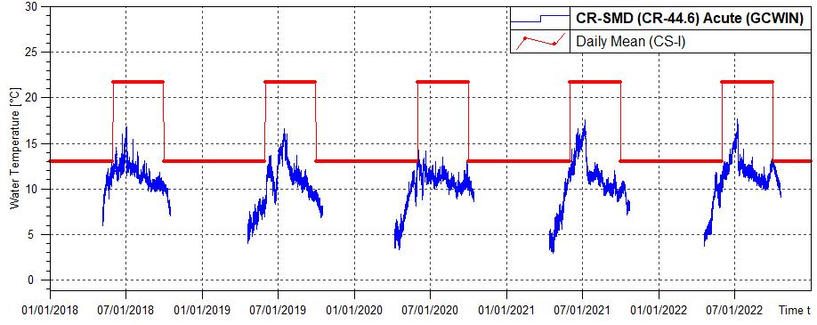
GCWIN/NW Site
Colorado downstream Shadow Mountain - CSI
2022 Above WAT Standard
5/16-5/31/22 | Max Exceedance: 10.4 ⁰C
10/1-10/19/22 | Max Exceedance: 12.6 ⁰C

Slide 49
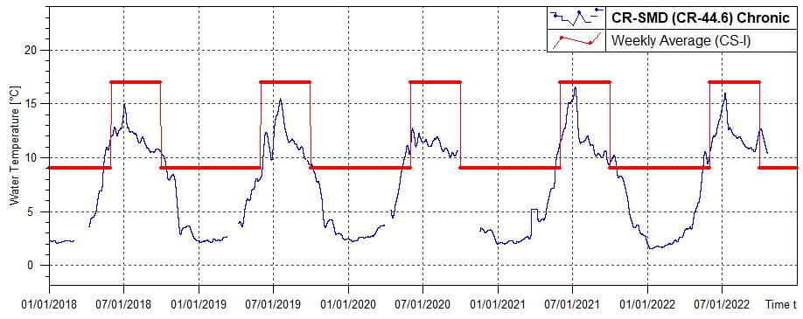
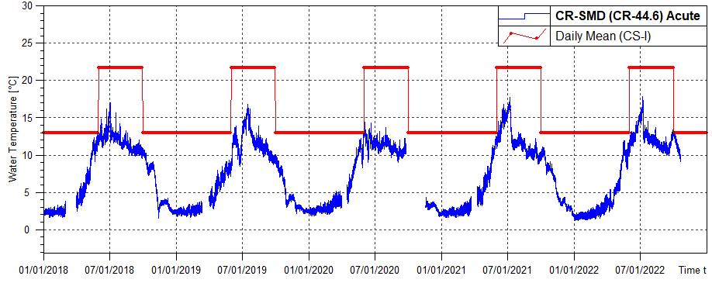
Northern Water Site
Colorado downstream Shadow Mountain - CSI
2022 Above WAT Standard
5/16-5/31/22 | Max Exceedance: 10.5 ⁰C
10/1-10/19/22 | Max Exceedance: 12.7 ⁰C

Slide 50
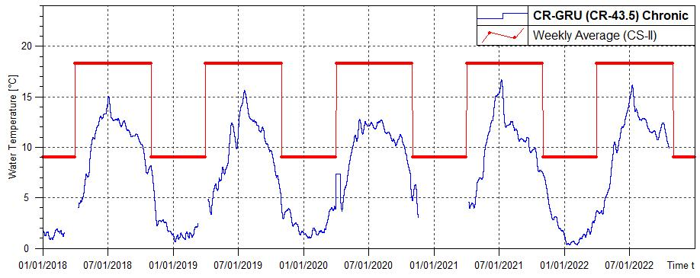
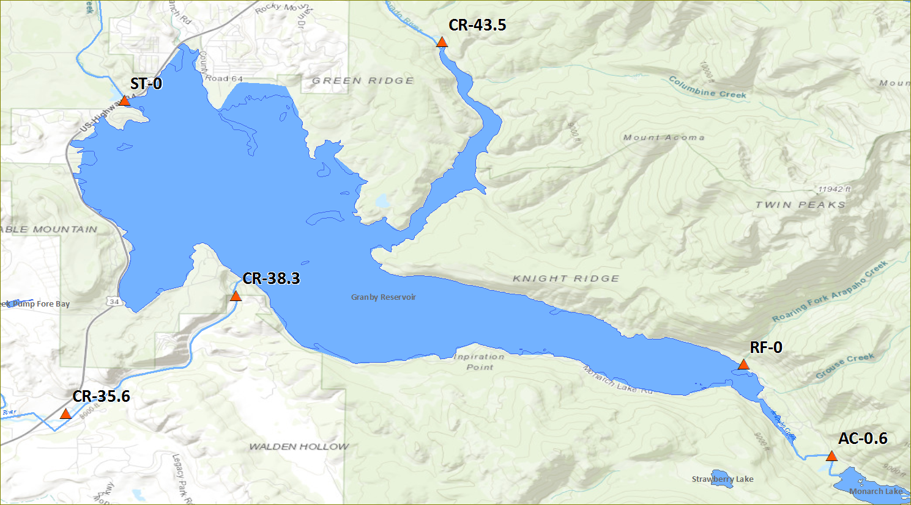
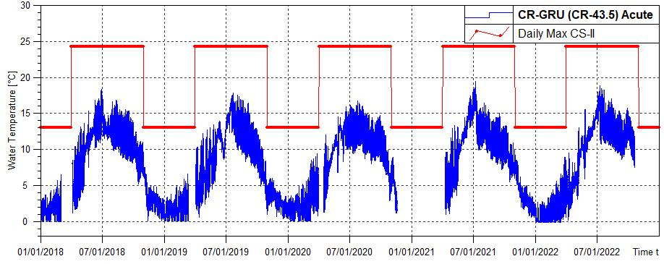
Colorado upstream Granby Reservoir - CSI

Slide 51
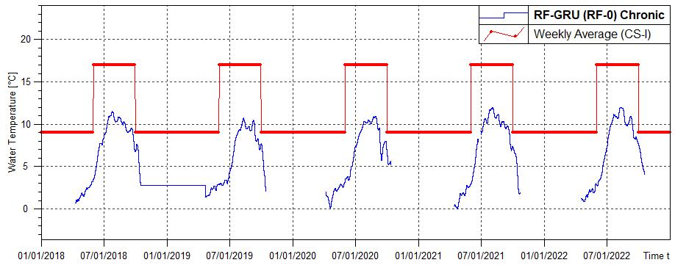
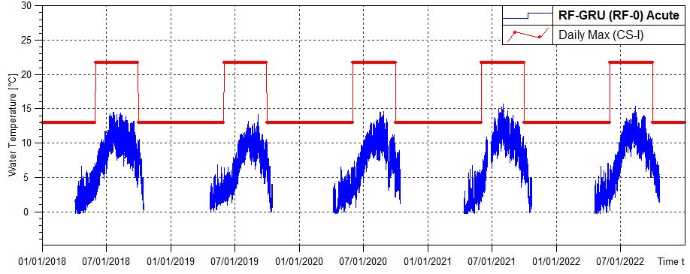
Roaring Fork - CSI

Slide 52
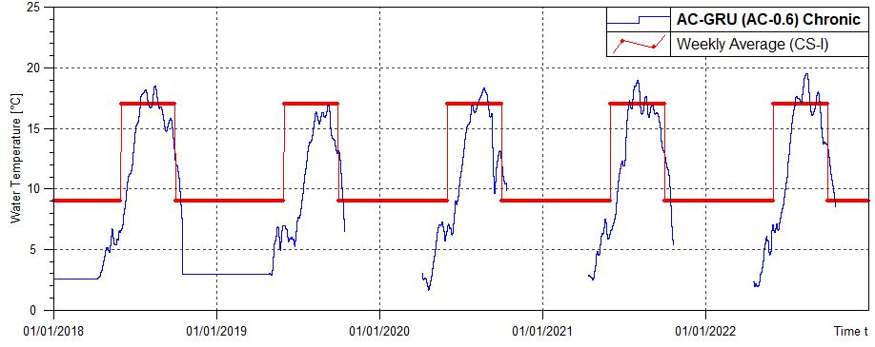
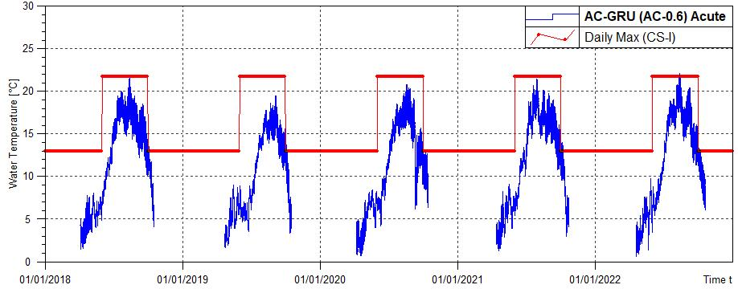
Arapaho Creek - CSI
2022 Above WAT Standard
8/11/2022 | Max Exceedance: 22.1⁰C
2022 Above DM Standard
7/20-8/22/2022 | Max Exceedance: 19.5 ⁰C
9/4-9/13/2022 | Max Exceedance: 18.0 ⁰C
10/1-10/17/2022 | Max Exceedance: 13.4 ⁰C

Slide 53
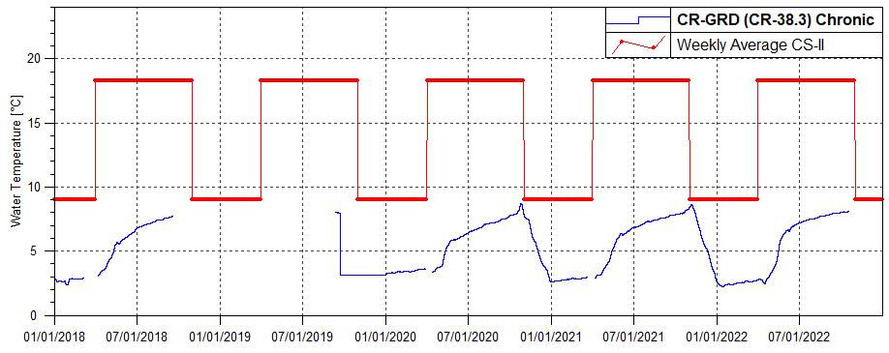
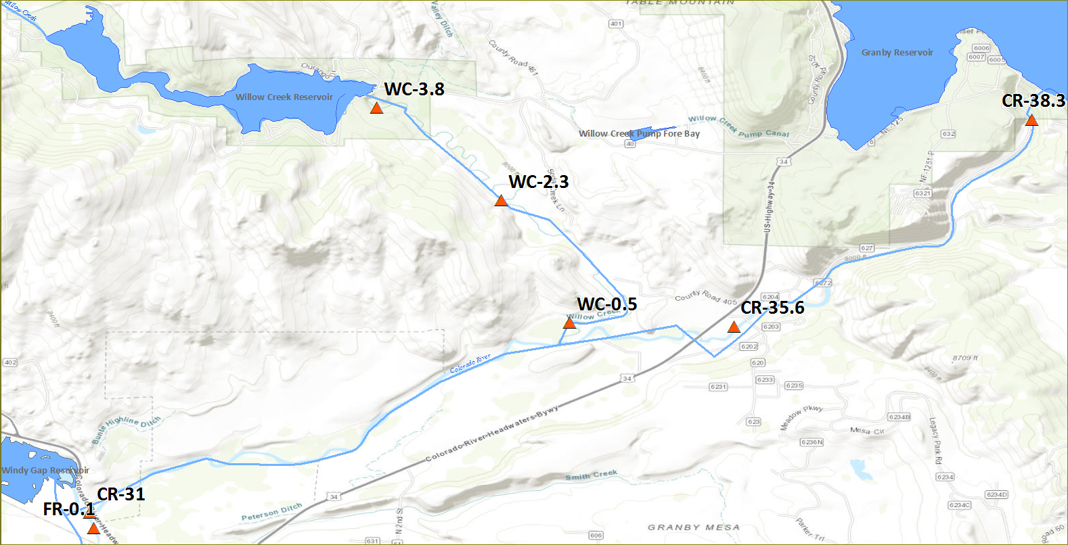
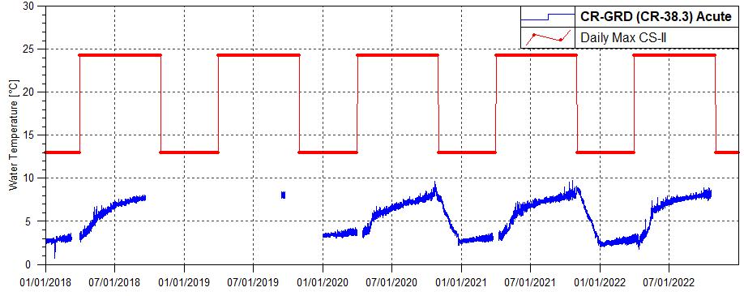
Colorado River downstream of Granby Reservoir- CSII
Missing data due to gage replacement
Notes:
Sensor removed for flume replacement
Reservoir effect

Slide 54
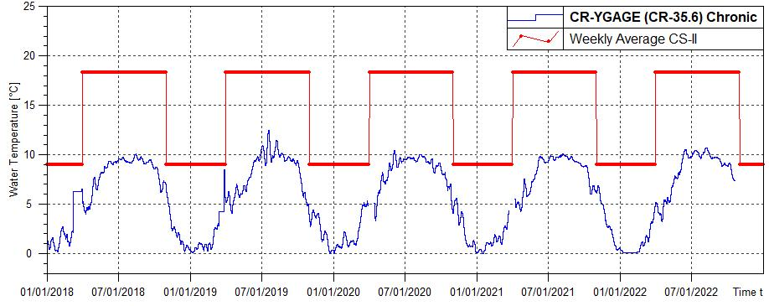
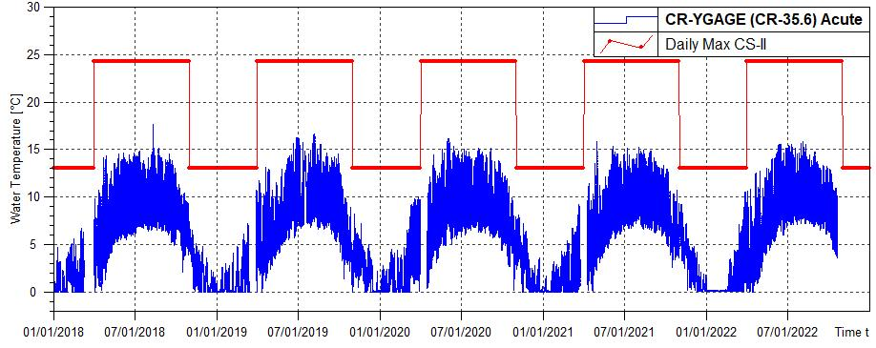
Colorado River at Y-Gage - CSII
Notes:
Less reservoir effect, warming

Slide 55
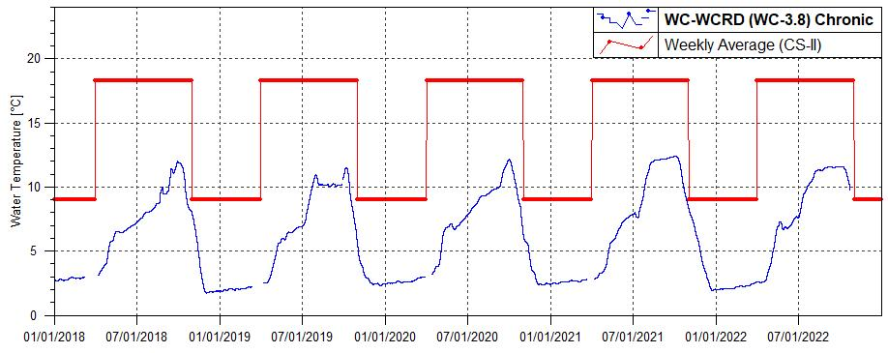
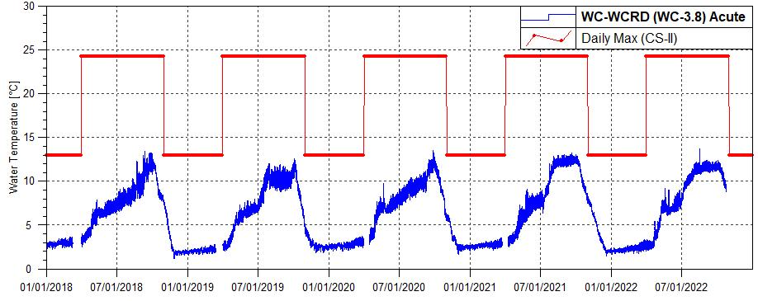
Willow Creek downstream of Reservoir – CS-II
Notes:
Changed from CSI to CSII at Reg 33 hearing – June 2019
Reservoir effect

Slide 56
Willow Creek upstream Bunte Highline – CS-II
Notes:
Changed from CSI to CSII at Reg 33 hearing – June 2019
Low flow, warming

Slide 57
Willow Creek upstream Colorado River – CS-II
Notes:
Changed from CSI to CSII at Reg 33 hearing – June 2019
Low flow, warming

Slide 58
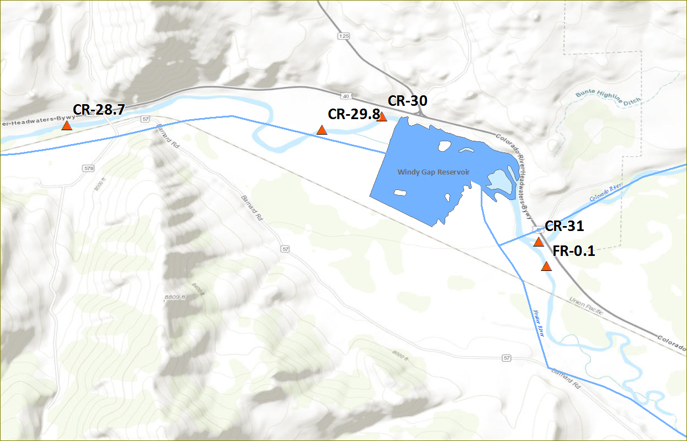
Colorado and Fraser Rivers
at Windy Gap
Notes:
No graph for CR-30 – bypass channel
No graph for CR-29.8 - Confluence of bypass and releases from WG

Slide 59
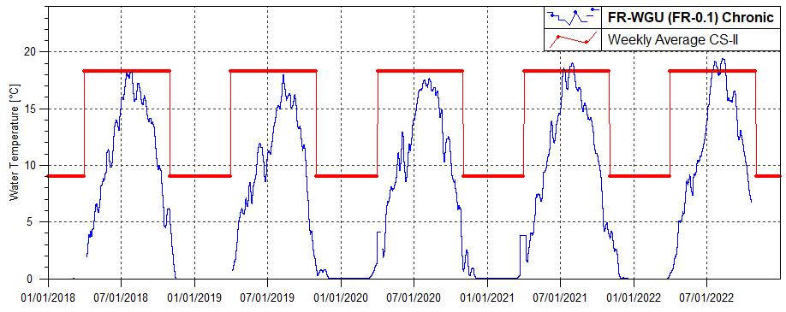
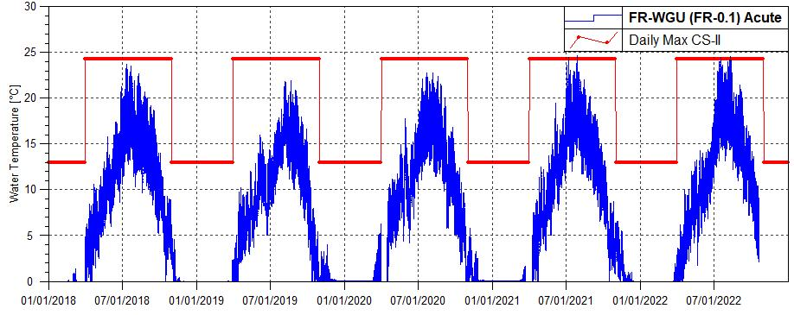
Fraser River upstream of
Windy Gap – CSII
2022 Above WAT standard
7-16-2022 – 7-28-2022 8-5-2022 – 8-17-2022 | Max Exceedance: 19.18⁰CMax Exceedance: 19.45⁰C
2022 Above DM standard
7-17-2022 8-10-2022 | Max Exceedance: 24.46⁰C Max Exceedance: 24.58⁰C
Notes:
No exceedances

Slide 60
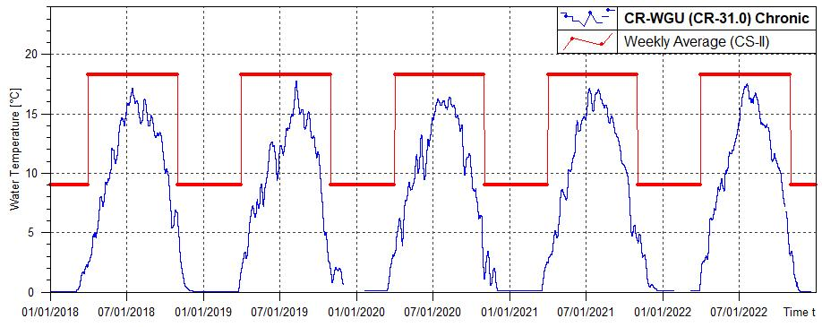
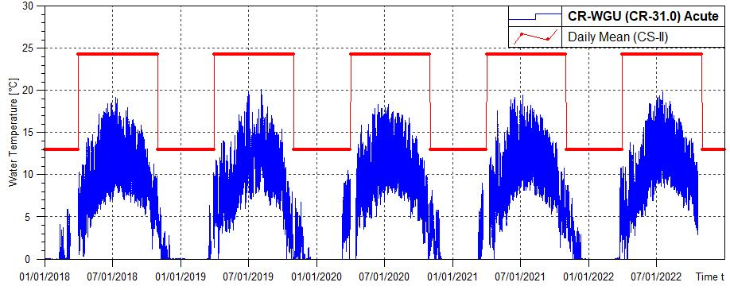
Colorado River upstream of
Windy Gap – CSII
Notes:
In general, low temps

Slide 61
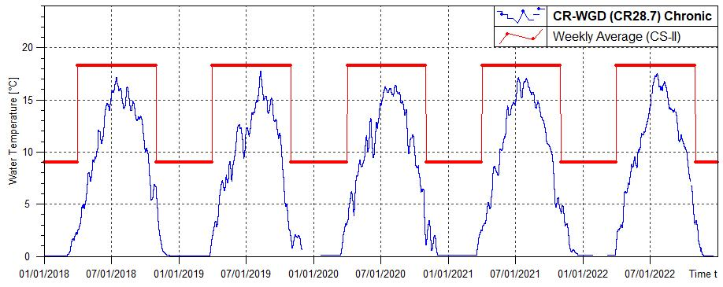
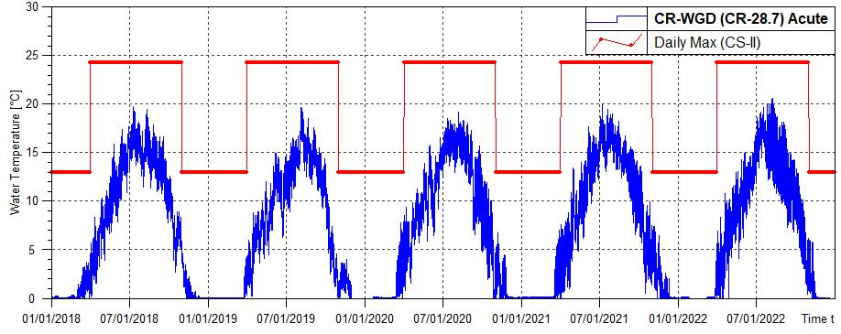
Colorado River downstream of Windy Gap – CSII
Northern Water's real-time site

Slide 62
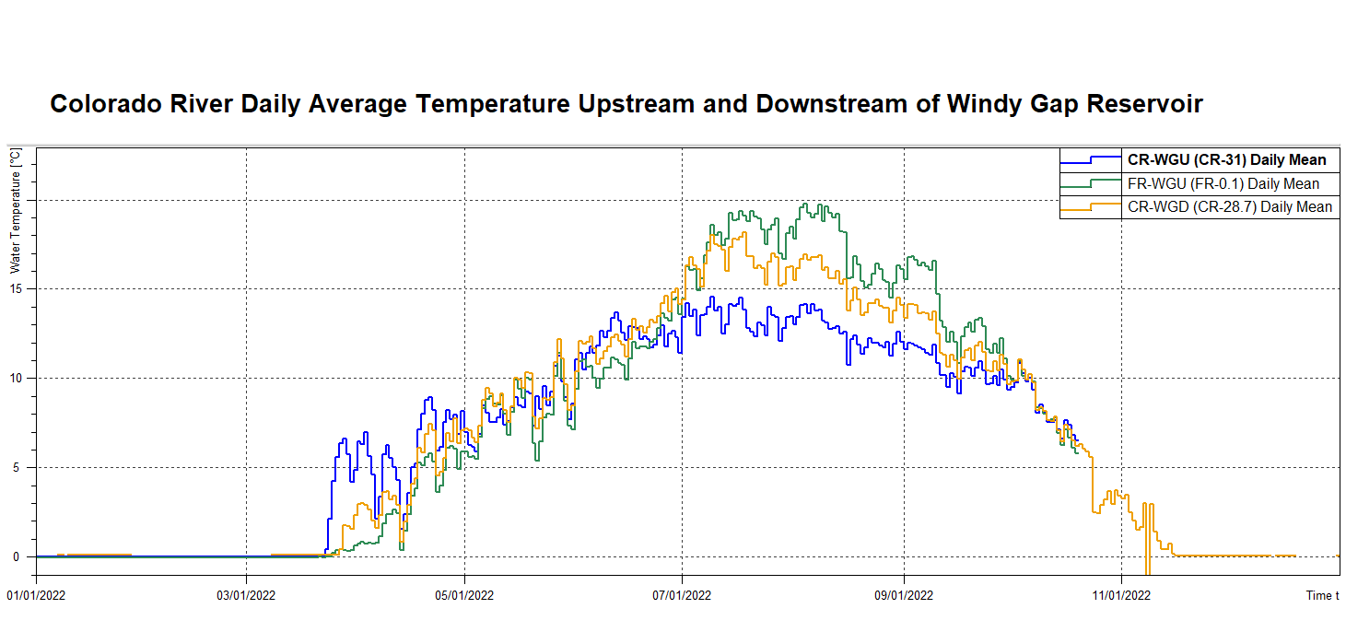

Slide 63
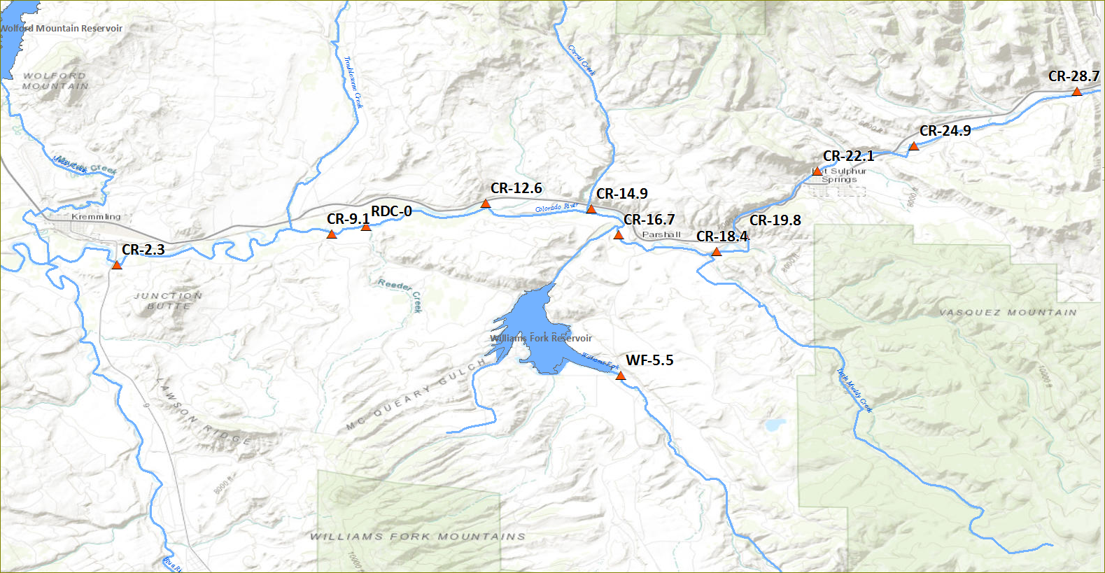
Colorado River –
Downstream of Windy Gap to Blue River
Notes:
303(d) listed segment – warming down to WF. WF cools river, them warms again

Slide 64
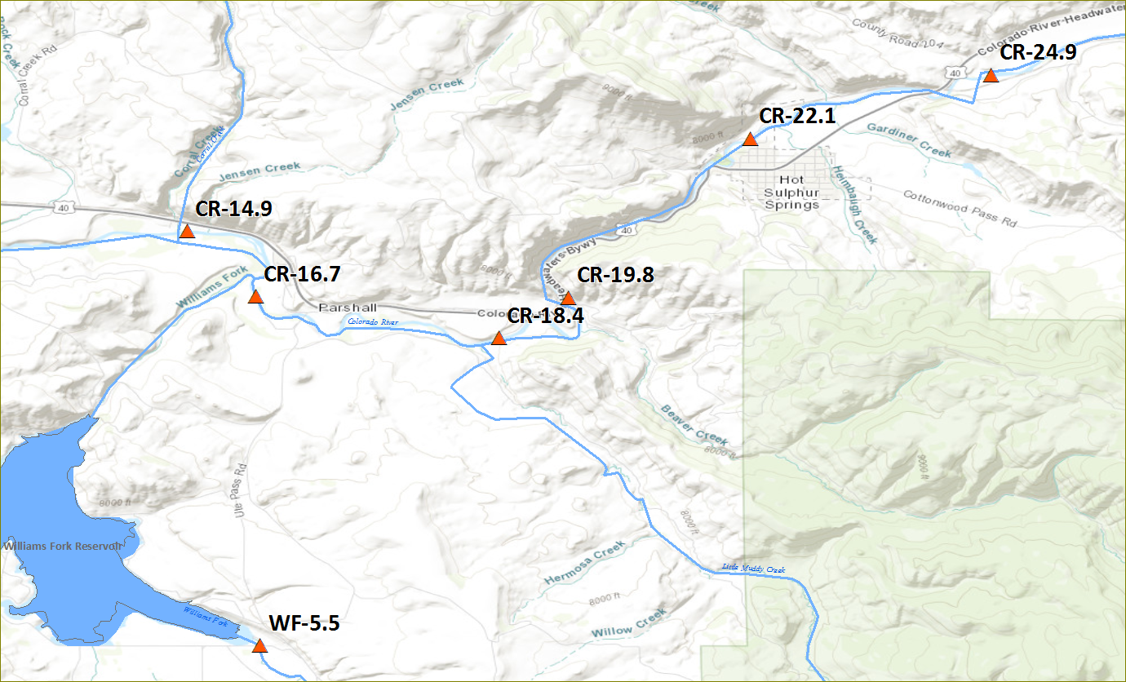
Colorado River at Sheriff Ranch – CSII

Slide 65
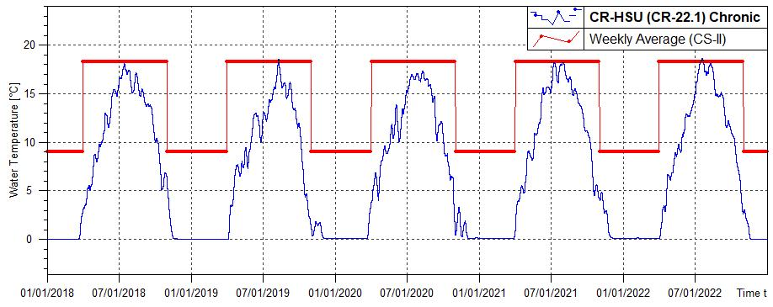
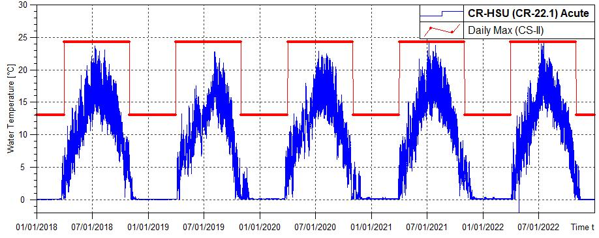
Colorado River upstream Hot Sulphur Springs – CSII
2022 Above WAT standard
7-15-2022 - 7-22-2022 | Max Exceedance: 18.6⁰C
2022 Above DM standard
7-17-2022 - 7-17-2022 | Max Exceedance: 24.3⁰C
Notes:
GCWIN maintained site prior to 2018

Slide 66
Colorado River downstream Byers Canyon– CSII
18.82 C on 7/20
2022 Above WAT standard
7-14-2022 to 7-22-2022 8-08-2022 to 8-10-2022 | Max Exceedance: 18.9⁰C Max Exceedance: 18.4⁰C

Slide 67
Colorado River at Lone Buck – CSII
19.06 C on 7/20
2022 Above WAT standard
07-13-2022 to 07-23-2022 08-05-2022 to 08-14-2022 | Max Exceedance: 19.1⁰C Max Exceedance: 19.0⁰C

Slide 68
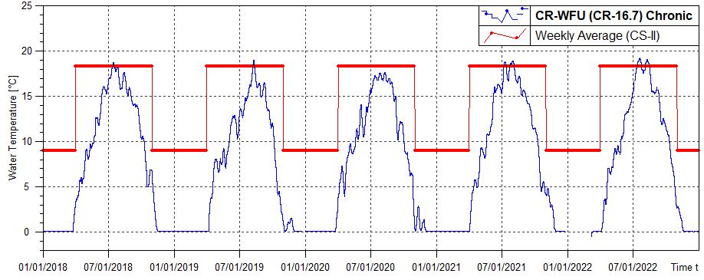
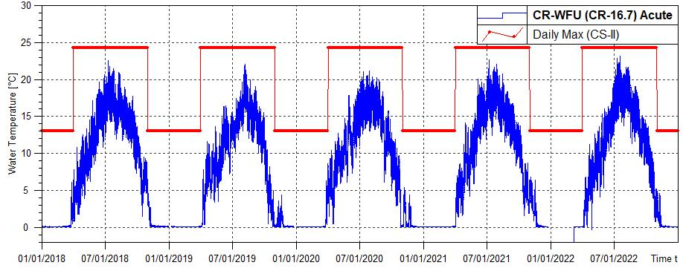
Colorado River upstream Williams Fork – CSII
2022 Above WAT standard
7-13-2022 - 7-24-2022 8-06-2022 - 8-16-2022 | Max Exceedance: 19.24⁰C Max Exceedance: 19.06⁰C
Notes:
No exceedances

Slide 69
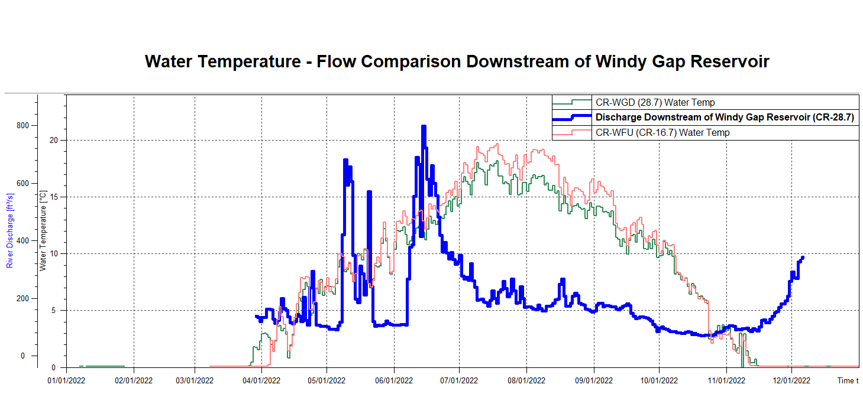

Slide 70
Colorado River downstream Williams Fork (Kid-Pond) – CSII

Slide 71
COR-LoneBuck COR-abvKidPond

Slide 72
Williams Fork upstream of Williams Fork Reservoir – CSI
10.19 C on 10/01
22.61 C on 8/10
2022 Above WAT standard
10-01-2022 to 10-08-2022 | Max Exceedance: 10.19⁰C
2022 Above DM standard
07-17-2022 to 08-12-2022 | Max Exceedance: 22.61⁰C

Slide 73
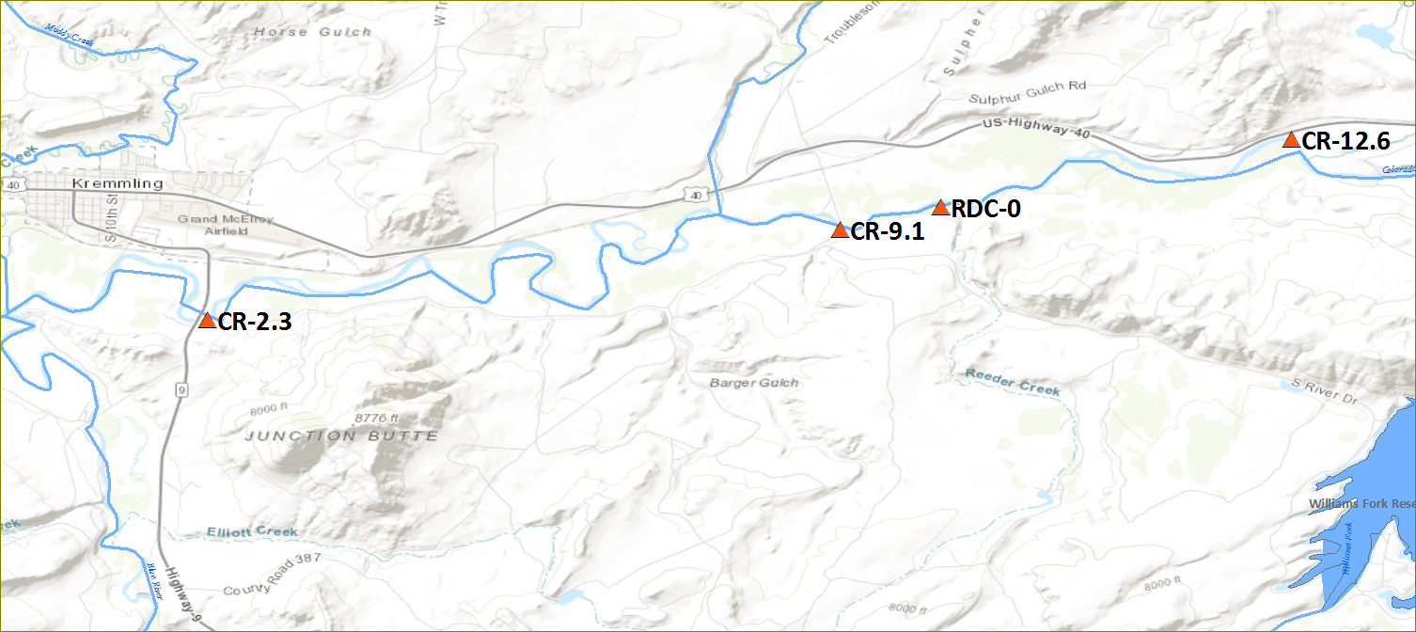
Colorado River at Con Ritschard – CSII

Slide 74
Colorado River downstream KB Ditch – CSII

Slide 75
CR 2.3 - Colorado River upstream Hwy 9 Bridge at Kremmling– CSII
Notes:
End of CEA
Warming occurring
BLM data completeness

Slide 76
Fraser River and Tributaries
River Mile ID | Description | River | Sampling Entity | Entity Station ID | Tier
FR-27.2 | Fraser River above Mary Jane entrance to Winter Park | Fraser River | GCWIN | FR-Upper | CS-I
FR-23.4 | Fraser River above Winter Park Sanitation District | Fraser River | GCWIN | FR-abvWPSD | CS-I
FR-23.2 | Fraser River below Winter Park Sanitation | Fraser River | GCWIN | FR-blwWPSD | CS-I
FR-22.5 | Fraser River below Winter Park Resort at Idlewild Campground | Fraser River | GCWIN | FR-blwWP | CS-I
EC-5.5 | Elk Creek below Denver Water diversion | Elk Creek | GCWIN | Elk‐blwDWB | CS-I
LVC-0.2 | Little Vasquez above Winter Park on Arapaho Road | Little Vasquez | GCWIN | LVC‐abvWP | CS-I
VC-0 | Vasquez Creek at the town of Winter Park | Vasquez Creek | GCWIN | VC-WP | CS-I
FR-20 | Fraser River at Rendezvous Bridge | Fraser River | GCWIN | FR-Rendezvous | CS-II
FR-18.1 | Fraser River below County Rd 804 | Fraser River | GCWIN | FR-CR804 | CS-II
STC-9.8 | Saint Louis Creek upstream of Denver Water Board diversion | St. Louis Creek | GCWIN | STC-blwDWB | CS-I
STC-5.4 | Saint Louis Creek at Fraser Experimental Forest | St. Louis Creek | GCWIN | STC-Mid | CS-I
STC-0 | Saint Louis Creek above confluence with Fraser River | St. Louis Creek | GCWIN | ST-LC | CS-I
FR-17.7 | Fraser River below County Rd 8 at Hammond Ditch | Fraser River | GCWIN | FR-blwCR8HD | CS-II
FR-16.9 | Fraser River above Fraser Sanitation | Fraser River | GCWIN | FR-abvFSD | CS-II
FR-16.6 | Fraser River below Fraser Sanitation | Fraser River | GCWIN | FR-blwFSD | CS-II
FR-15 | Fraser River LBD Restoration Project, Upstream end | Fraser River | GCWIN | FR-SpProjU | CS-II
FR-14.4 | Fraser River LBD Restoration Project, Downstream end | Fraser River | GCWIN | FR-SpProjD | CS-II

Slide 77
Fraser River and Tributaries
River Mile ID | Description | River | Sampling Entity | Entity Station ID | Tier
FR-14 | Fraser River At Tabernash Co. | Fraser River | USGS | 09027100 | CS-II
LCB-2.2 | Little Cabin Creek below Denver Water diversion | Little Cabin | GCWIN | LCAB‐blwDWB | CS-I
CB-2.7 | Cabin Creek below Denver Water diversion | Cabin Creek | GCWIN | CAB‐blwDWB | CS-I
CB-0.6 | Cabin Creek upstream of North and South Channels | Cabin Creek | GCWIN | CAB-abvChan | CS-I
RC-4.7 | Ranch Creek below County Rd 8315 | Ranch Creek | GCWIN | RC-blwCR8315 | CS-I
HC-0.5 | Herd Creek on County Road 843 | Herd Creek | GCWIN | HRD‐atCR843 | CS-I
MC-0.5 | Meadow Creek on County Road 84/USFS 129 | Meadow Creek | GCWIN | MEA‐atCR84 | CS-I
RC-1.1 | Ranch Creek below Meadow Creek | Ranch Creek | GCWIN | RC-blwMC | CS-I
FR-12.4 | Fraser River above Fraser Canyon below Tabernash | Fraser River | GCWIN | FR-abvFrCan | CS-II
FR-4.5 | Fraser River below Fraser Canyon at Granby Ranch | Fraser River | GCWIN | FR-blwFrCan | CS-II
FR-3.5 | Fraser River below Highway 40 in Granby | Fraser River | GCWIN | FR-Hwy40Gr | CS-II
FR-1.9 | Fraser River above Granby Sanitation District | Fraser River | GCWIN | FR-abvGSD | CS-II
FR-1.6 | Fraser River below Granby Sanitation District | Fraser River | GCWIN | FR-blwGSD | CS-II

Slide 78
Colorado River- Headwaters to Windy Gap
River Mile ID | Description | River | Sampling Entity | Entity Station ID | Tier
EI-0.1 | East Inlet upstream of Grand Lake | East Inlet | Northern | EI-GLU | CS-I
NI-0.1 | North Inlet upstream Grand Lake | North Inlet | Northern | NI-GLU | CS-I
NF-0.1 | North Fork of Colorado River upstream Shadow Mountain Reservoir | North Fork | Northern | CR-SMU | CS-I
CR-44.6 | Colorado River downstream of Shadow Mountain Reservoir | Colorado River | Northern | CR-SMD | CS-I
CR-43.5 | Colorado River upstream of Lake Granby | Colorado River | Northern | CR-GRU | CS-I
ST-0 | Stillwater Creek upstream Lake Granby | Stillwater Creek | Northern | ST-GRU | CS-I
RF-0 | Roaring Fork upstream Lake Granby | Roaring Fork | Northern | RF-GRU | CS-I
AC-0.6 | Arapaho Creek upstream Lake Granby | Arapaho Creek | Northern | AC-GRU | CS-I
CR-38.3 | Colorado River downstream of Lake Granby | Colorado River | Northern | CR-GRD | CS-II
CR-35.6 | Colorado River downstream of Lake Granby at flow gage | Colorado River | Northern | CR-YGAGE | CS-II
WC-3.8 | Willow Creek downstream of Willow Creek Reservoir | Willow Creek | Northern | WC-WCRD | CS-I
WC-2.3 | Willow Creek upstream of Bunte Highline Ditch | Willow Creek | GCWIN | WC-abvBHD | CS-I
WC-0.5 | Willow Creek upstream of confluence with Colorado River | Willow Creek | GCWIN | WC-abvCOR | CS-I

Slide 79
Colorado and Fraser River at Windy Gap
River Mile ID | Description | River | Sampling Entity | Entity Station ID | Tier
CR-31 | Colorado River upstream of Windy Gap and Fraser River confluence | Colorado River | Northern | CR-WGU | CS-II
FR-0.1 | Fraser River upstream of confluence with Colorado River | Fraser River | Northern | FR-WGU | CS-II
CR-30 | Colorado River at Windy Gap Bypass | Colorado River | Northern | CR-WGB | CS-II
CR-29.8 | Colorado River at confluence of Windy Gap spillway and bypass | Colorado River | Northern | CR-WGC | CS-II
CR-28.7 | Colorado River downstream of Windy Gap Reservoir | Colorado River | Northern | CR-WGD | CS-II

Slide 80
Colorado River- Downstream Windy Gap to Blue River
River Mile ID | Description | River | Sampling Entity | Entity Station ID | Tier
CR-24.9 | Colorado River at Sheriff Ranch | Colorado River | GCWIN | COR-SHRF | CS-II
CR-22.1 | Colorado River upstream Hot Sulphur Springs | Colorado River | Northern | CR-HSU | CS-II
CR-19.8 | Colorado River downstream of Byers Canyon | Colorado River | GCWIN | COR-blwByers | CS-II
CR-18.4 | Colorado River at Lone Buck | Colorado River | GCWIN | COR-LoneBuck | CS-II
CR-16.7 | Colorado River upstream of Williams Fork | Colorado River | Northern | CR-WFU | CS-II
WF-5.5 | Williams Fork upstream of Williams Fork Reservoir | Williams Fork | GCWIN | WF-abvWFR | CS-I
CR-14.9 | Colorado River above Kid Fishing Pond | Colorado River | GCWIN | COR-abvKidPond | CS-II
CR-12.6 | Colorado River at ConRitschard | Colorado River | GCWIN | COR-ConRitschard | CS-II
RDC-0 | Reeder Creek upstream of Colorado River confluence | Reeder Creek | BLM | REE-Upper | CS-II
CR-9.1 | Colorado River downstream of KB Ditch | Colorado River | GCWIN | COR-KBDitch | CS-II
CR-2.3 | Colorado River upstream Hwy 9 Bridge at Kremmling | Colorado River | BLM | COR-Hwy9 | CS-II
MC-2.1 | Muddy Creek below Hwy 40 in Kremmling | Muddy Creek | BLM | MC-blwHwy40 | CS-II

Slide 81
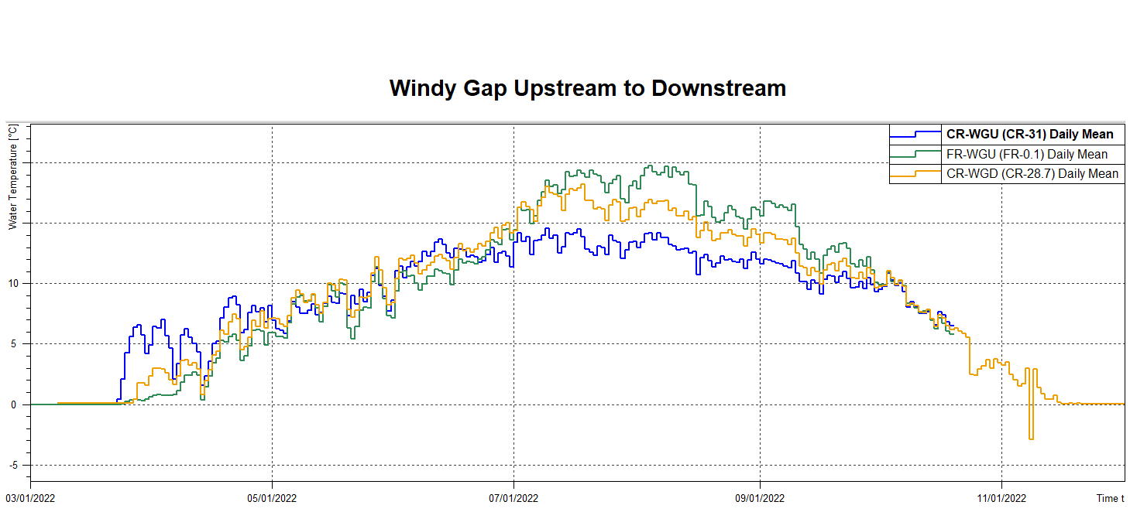
Notes:
Fraser River driver for temperature downstream of Windy Gap during summer.
Cold snap in Sept

Slide 82
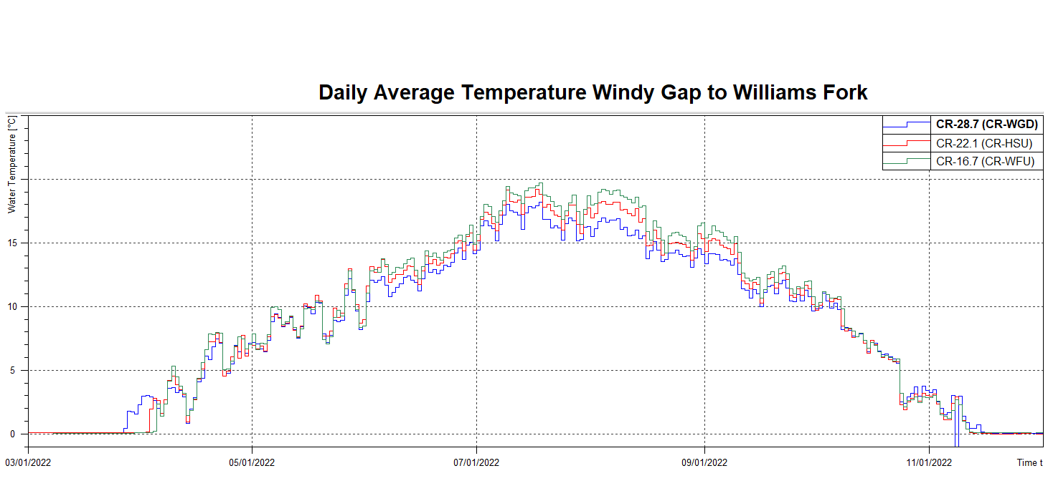

Slide 83
RDC 0.0 - Reeder Creek upstream Colorado River – CSII

